Slide 1
IMAGE ANALYSIS AND COMPUTER VISION
MEMBERS OF THE PROJECT:
SIDDHANT RAMBHAD BT22ECE008
VINAY KHARATMOL BT22ECE097
NAYAN SINGHANIA BT22ECE115

Slide 2
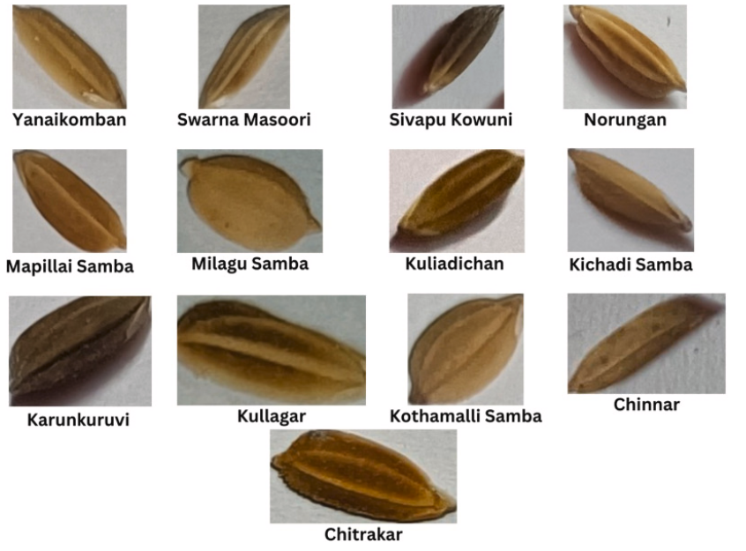
Seed Variety Identification Using Deep Neural Network
INTRODUCTION:
Agriculture plays a critical role in the economy and food security of many nations. Ensuring the quality and authenticity of seeds is a fundamental requirement in crop production, affecting yield, disease resistance, and market value. Traditionally, seed identification and classification are performed manually, which is time-consuming, error-prone, and requires expert knowledge.
To address these challenges, this project introduces SeedNet — an automated deep learning-based classification system capable of identifying multiple seed varieties such as:
Chana Dal
Chinoor Rice
HMT Juna Rice
Lakhodi Dal
Toor Dal
Wheat
By leveraging convolutional neural networks (CNNs) and a custom image dataset, this project aims to streamline the classification process, enabling faster, more accurate, and scalable identification of seeds for use in agricultural quality control, seed certification, and inventory management.

Slide 3
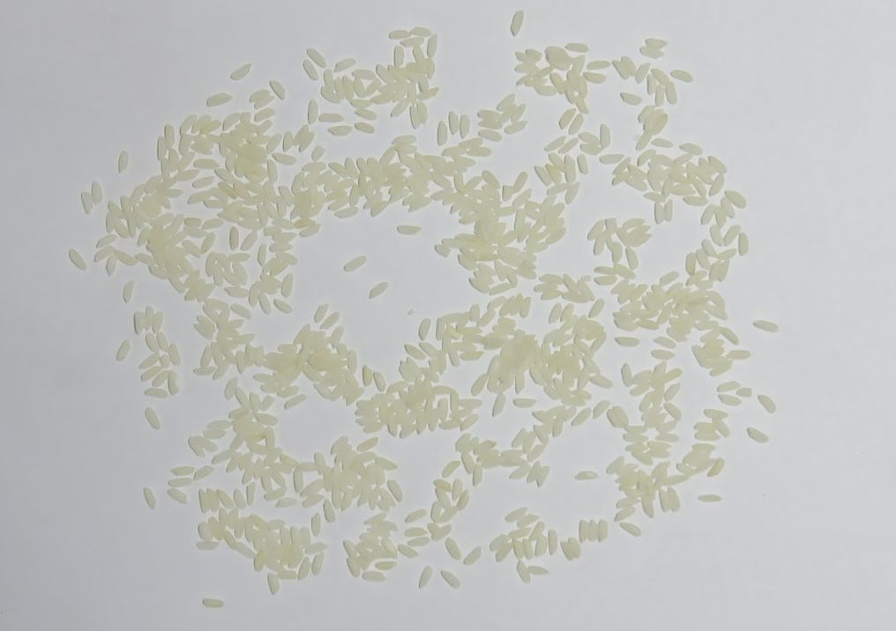
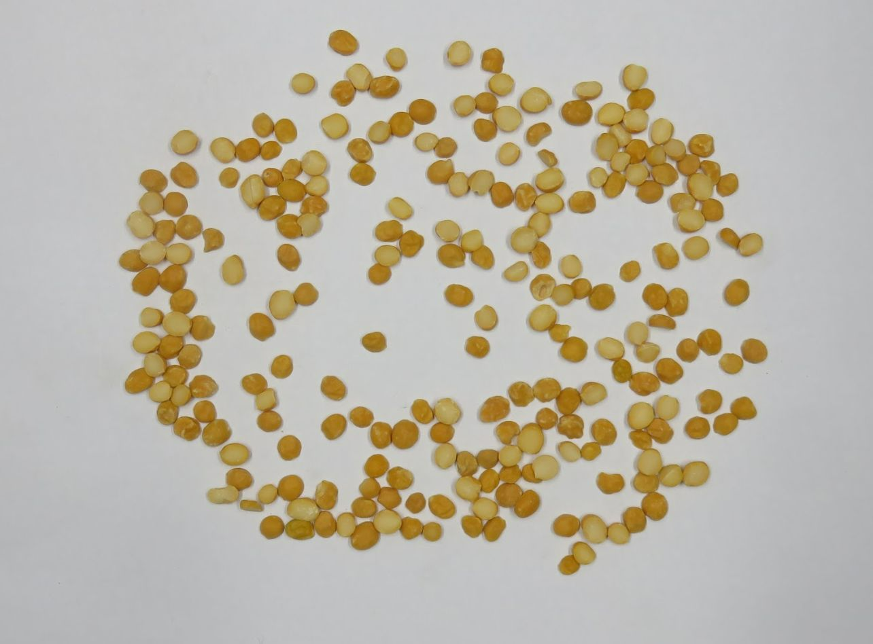
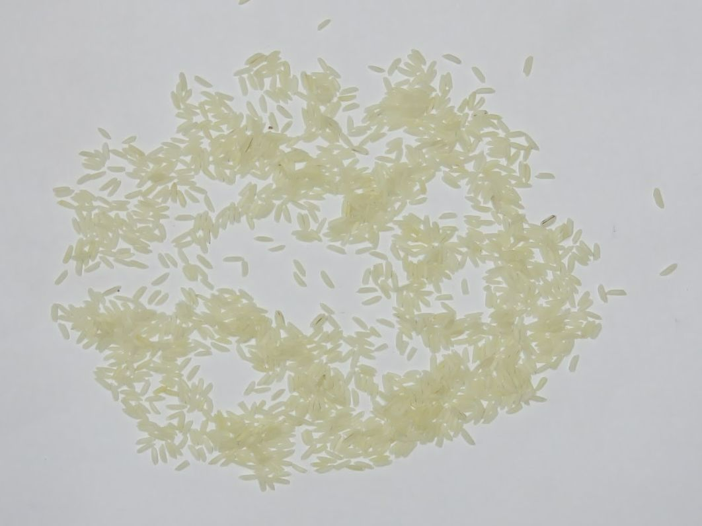
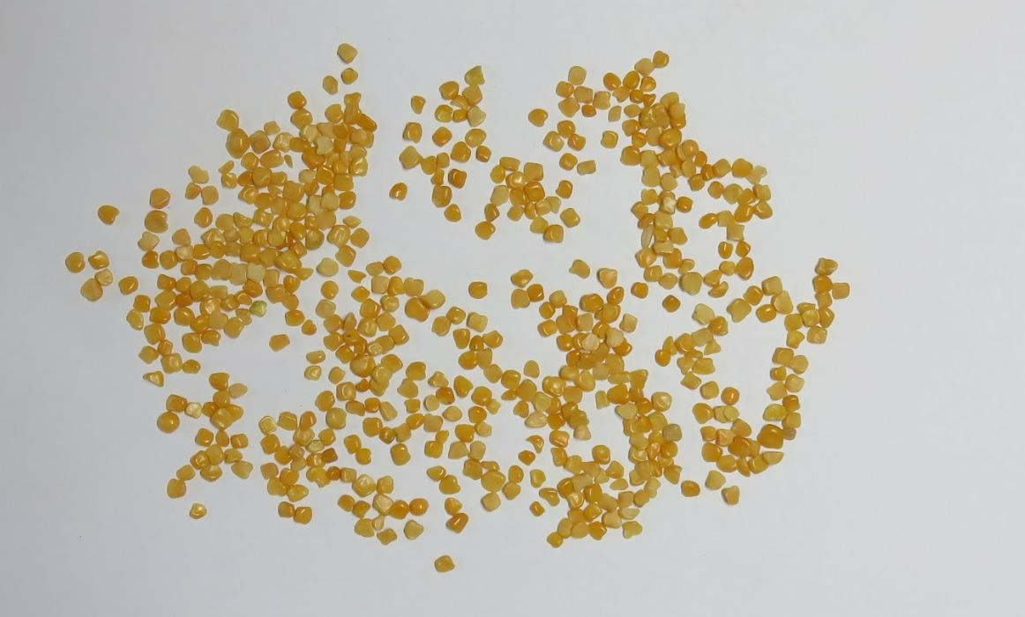
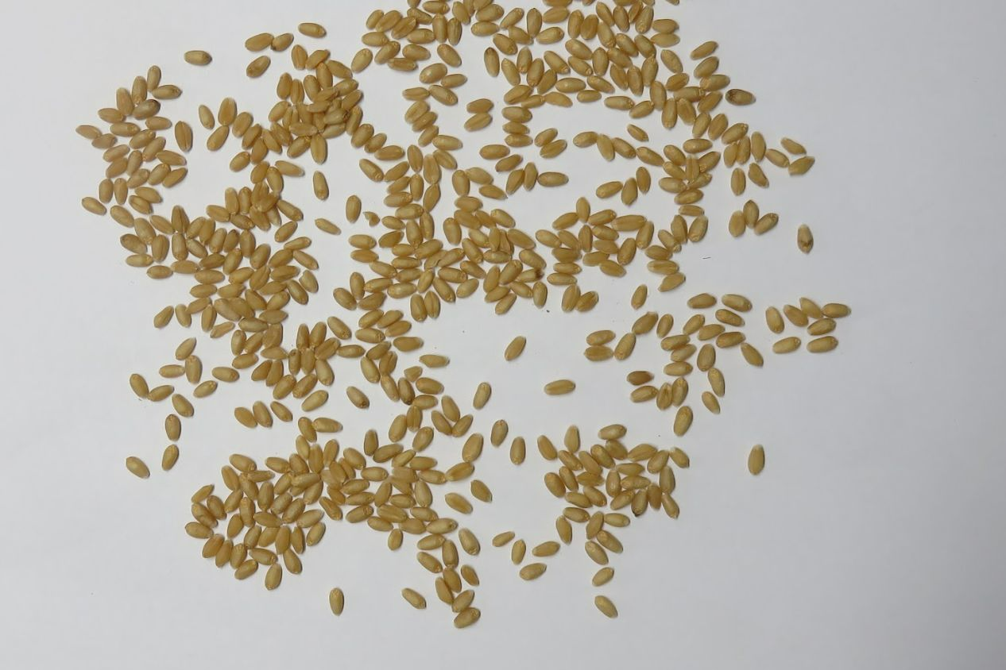
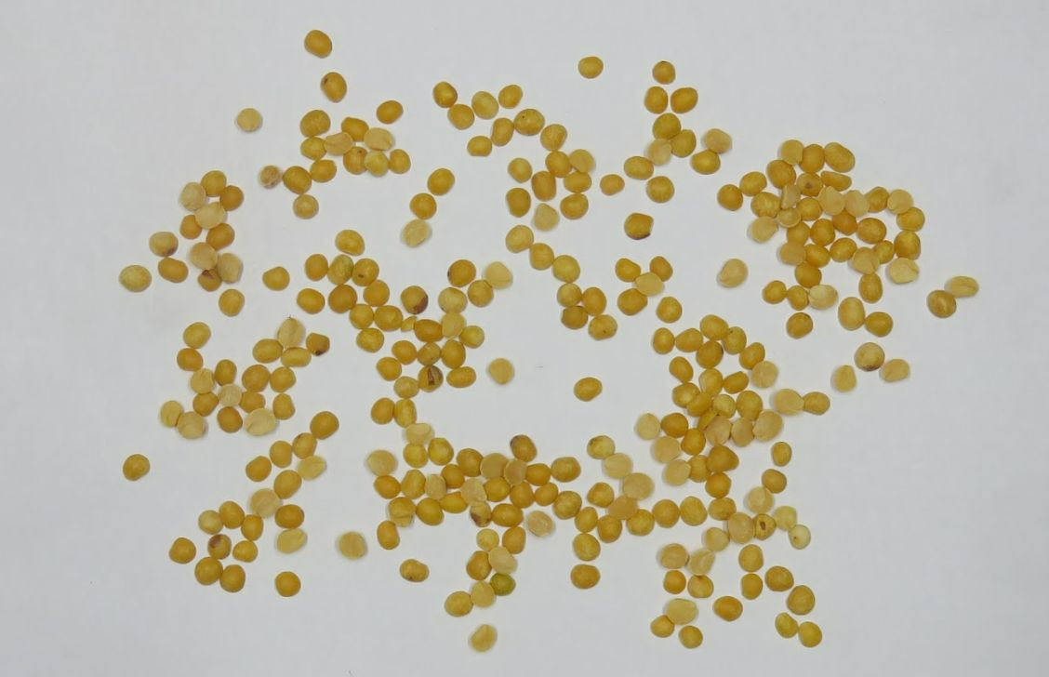
WHY THIS PROJECT?
Need for Automation
Manual grain/seed identification is slow, error-prone, and requires expertise.
Our Aim
Use deep learning (ResNet18) to classify:
Chana Dal, Toor Dal, Lakhodi Dal
Chinoor Rice, HMT Juna Rice, Wheat
Custom Dataset
Self-created dataset ensures real-world relevance and better model performance.
Scalable Solution
Easily extendable to other grains or agri-products for smart farming and quality control.
Learning Outcome
Hands-on with CNNs, PyTorch, and model deployment for practical agricultural-tech.

Slide 4
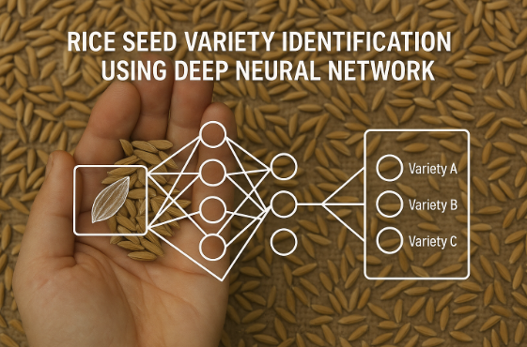
HOW DID WE DO THIS PROJECT?
1. Dataset Creation
Collected images of Chana Dal, Toor Dal, Lakhodi Dal, Chinoor Rice, HMT Juna Rice, and Wheat.
Ensured a diverse set of images under various lighting conditions, angles, and seed types for better model generalization.
2. Data Preprocessing
Applied image transformations:
Resize to 224x224 pixels
Random horizontal flip, rotation (for data augmentation)
Split dataset into train, validation, and test sets (60% training, 20% validation, 20% testing).
3. Model Selection & Training
Used ResNet18 pre-trained on ImageNet for transfer learning.
Modified the final layer to match our dataset’s six seed types.
Trained the model using Cross-Entropy Loss and Adam optimizer.
j

Slide 5
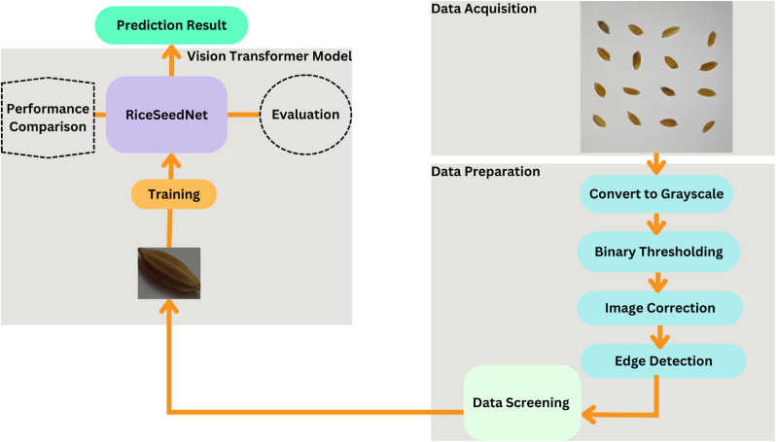
4. Model Evaluation
Evaluated performance on validation data after each epoch.
Achieved accuracy metrics to assess model’s effectiveness.
5.Testing & Prediction
Tested the final model on unseen images.
Integrated a real-time prediction function for seed classification using new images.
6. Visualization & Results
Plotted training losses and validation accuracy over epochs.
Achieved high test accuracy for seed classification.

Slide 6
MODEL TRAINING PROCESS
Model Selection (Transfer Learning)
Chose ResNet18 architecture, a convolutional neural network (CNN) pre-trained on ImageNet (over 1 million images).
Transfer learning enables leveraging learned features (edges, textures, patterns) for seed classification, reducing the need for a large dataset.
2.Modifying the Final Layer
ResNet18 typically classifies 1,000 classes, so we replaced the final fully connected layer (fc) with a custom layer:
Input features: 512 (size of the output from ResNet18’s penultimate layer)
Output features: 6 (representing our seed categories: Chana Dal, Toor Dal, Lakhodi Dal, Chinoor Rice, HMT Juna Rice, and Wheat).

Slide 7
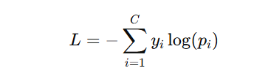
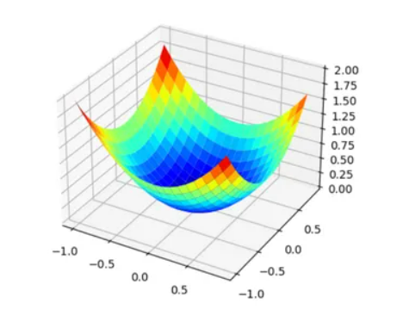
3.Loss Function
Cross-Entropy Loss was used, which is suitable for classification tasks where multiple classes exist.
It computes the softmax function on the model’s outputs and compares the predicted probability distribution with the actual label:
Formula:
where C is the number of classes, yi is the true label, and pi​ is the predicted probability for class iii.
4.Optimizer: Adam
Adam (Adaptive Moment Estimation) optimizer was chosen for its efficiency in training deep networks:
Adaptive Learning Rate: It adjusts the learning rate for each parameter based on gradients.
Beta Parameters: β1=0.9 and β2=0.999, these values help smooth out the gradient updates.
Learning rate: 0.001 was selected to prevent overshooting during fine-tuning and ensure stable convergence.

Slide 8
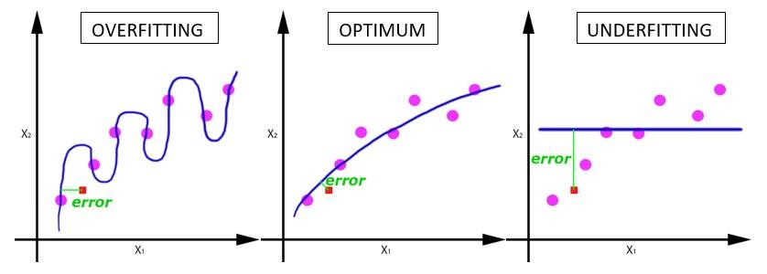
5.Training Setup
Batch Size = 32: Each batch processes 32 images, improving the model’s ability to generalize.
Epochs = 10: The model is trained for 10 complete iterations over the dataset.
Utilized GPU for faster matrix computations, reducing training time from days to hours.
6.Training Loop
Forward Pass: Input images are passed through the ResNet18 model to produce output logits (raw class scores).
Softmax Activation: The logits are transformed into probabilities using the Softmax function.
Loss Calculation: The predicted probabilities are compared with the true labels using Cross-Entropy Loss.
Backpropagation: Gradients are calculated and propagated backward from the output to the input layer to update weights using the chain rule of differentiation.
Gradient Descent: Adjusts the weights to minimize the loss.

Slide 9
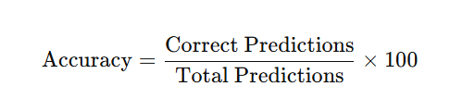
7.Validation and Monitoring
Validation Phase: After each epoch, the model’s performance is evaluated on the validation set, ensuring it’s not overfitting.
Accuracy Metrics:
Monitoring:
Training Loss: Tracks the model’s performance during training.
Validation Accuracy: Monitors model generalization and detects overfitting (if training accuracy increases, but validation accuracy stagnates or decreases).
8.Early Stopping Consideration
Though not implemented here, an early stopping mechanism can be used to stop training when the validation accuracy stops improving, preventing overfitting and saving time.

Slide 10
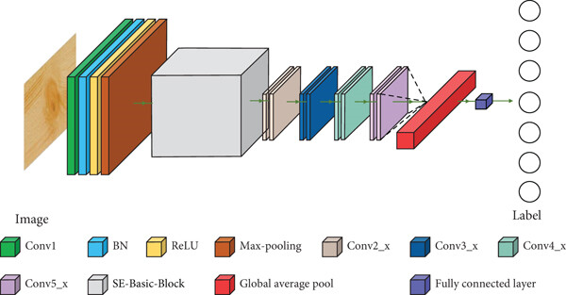
Architecture Used
Model Chosen: Pre-trained ResNet18 (Residual Network with 18 layers)
Why ResNet18?
Lightweight yet powerful convolutional neural network (CNN)
Pre-trained on ImageNet → helps with better generalization on small custom datasets
Residual connections mitigate vanishing gradient problem
Modifications Made:
Final fully connected (FC) layer modified to match our number of classes: → model.fc = nn.Linear(model.fc.in_features, 6)
Input Size: 224×224 RGB images
Activation Function: ReLU (inside ResNet blocks)
Final Layer: Softmax over 6 classes (Chana Dal, Lakhodi Dal, Toor Dal, Wheat, HMT Juna Rice, Chinoor Rice)

Slide 11
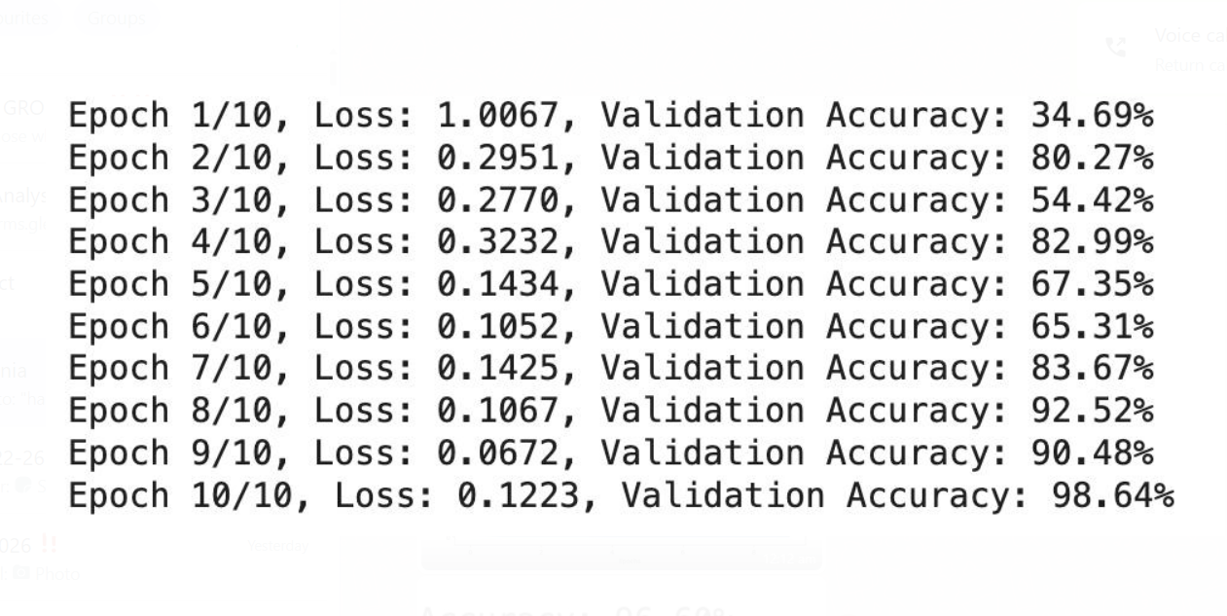
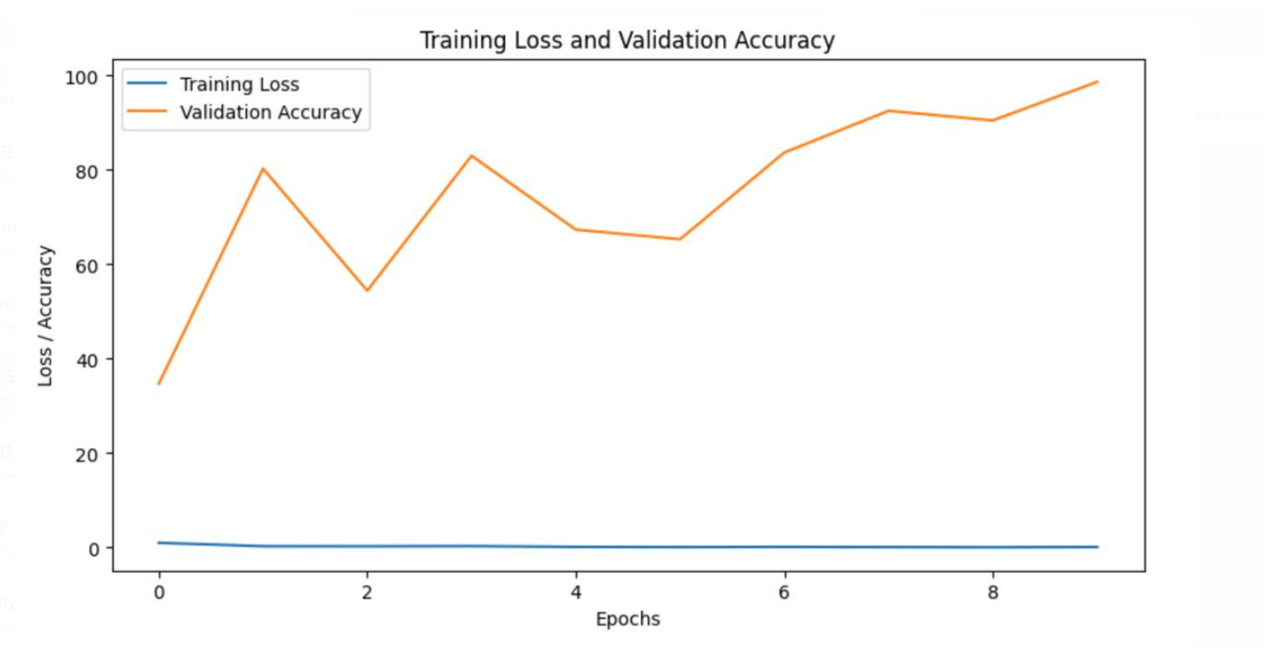
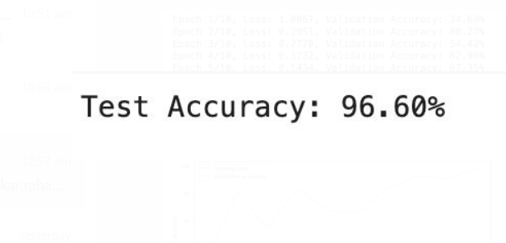
RESULTS

Slide 12
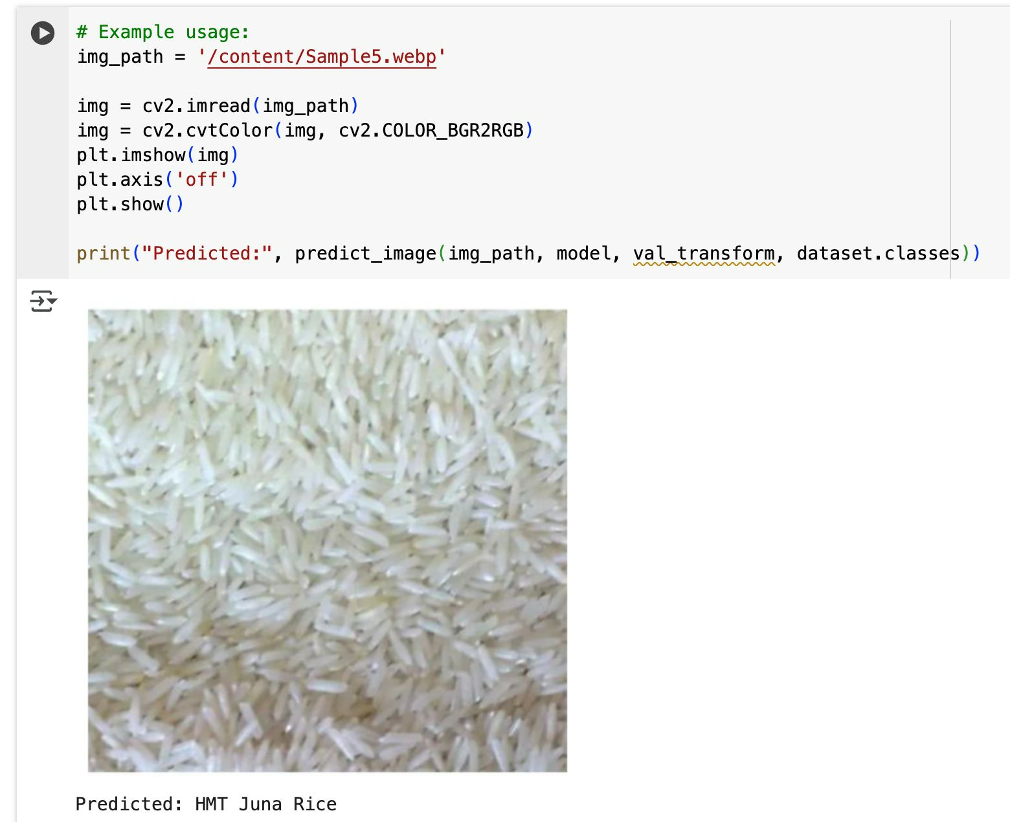
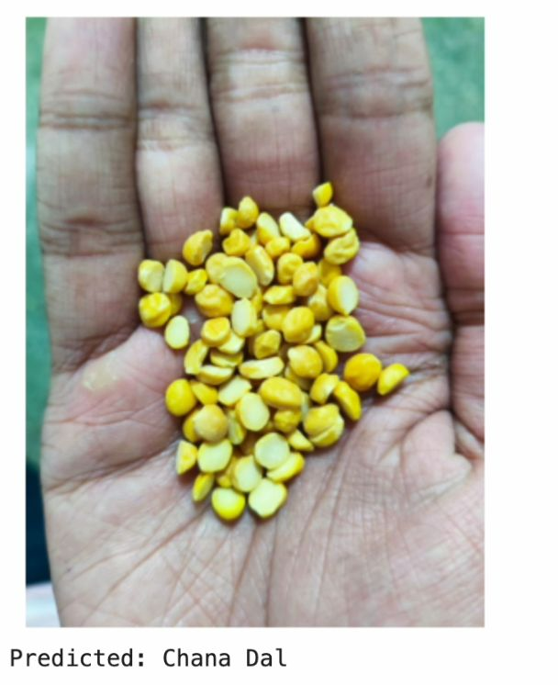
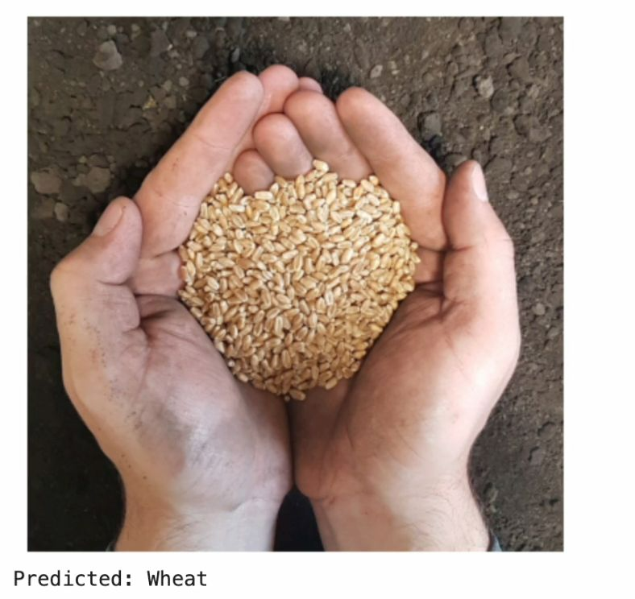
RESULTS

Slide 13
CHALLENGES AND LIMITATIONS
Corrupted Images
Some dataset images failed to load
Handled using a custom image loader to skip broken files
Class Imbalance
Uneven number of samples for some grain types
Could affect model's prediction fairness
Limited Hardware Resources
Training done on Google Colab with GPU
Required efficient batch sizes and smaller model (ResNet18)
Dataset Quality
Custom-built dataset meant manual curation
Varying lighting/backgrounds introduced slight noise

Slide 14
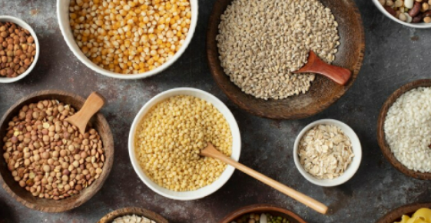
APPLICATIONS
Food Grain Classification Automatically identify and sort different grains like rice, dal, and wheat
Seed Certification & Quality Control Ensures correct labeling and quality validation during packaging
Inventory & Storage Management Helps warehouses or storage units keep accurate digital records
Automation in Food Industry Can be integrated into machines for real-time sorting or detection
Educational & Research Tool Serves as a dataset and model for agricultural AI research and learning

Slide 15
FUTURE SCOPE
Expand Dataset Variety Include more seed and grain types for broader classification capability
Improve Model Accuracy Fine-tune deeper architectures or use ensemble methods
Real-Time Mobile App Integration Deploy the model in a mobile app for on-field identification
Edge Deployment on Embedded Devices Run the model on devices like Raspberry Pi for portable automation
Introduce Quality Grading Classify not just type but also grade/quality of grains
Add Multilingual Interface Make the system accessible to regional farmers through local languages

Slide 16
CONCLUSION
Successfully developed a deep learning-based system for classifying multiple types of grains such as rice varieties, dals, and wheat
Demonstrated high accuracy in training, validation, and testing phases
Helps automate the process of grain identification, supporting agricultural efficiency
The system shows strong potential for real-world deployment in inventory, certification, and sorting applications
Future improvements can enhance accuracy, usability, and scalability of the solution
DATA SET LINK:https://drive.google.com/drive/folders/1v11axFHP1xx3fRLh3WJ36VBO46a2yieO?usp=sharing

